Slide 1
Deliberate Investing. Intentional Value.
Standpoint.
hviaonline.com

Slide 2
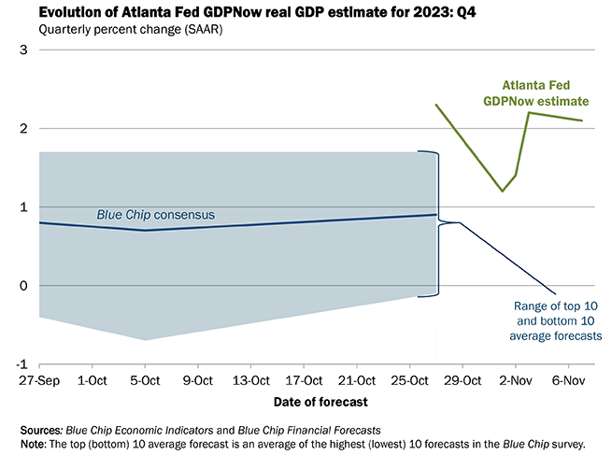
Deliberate Investing. Intentional Value.
GDP continues to power ahead
hviaonline.com

Slide 3
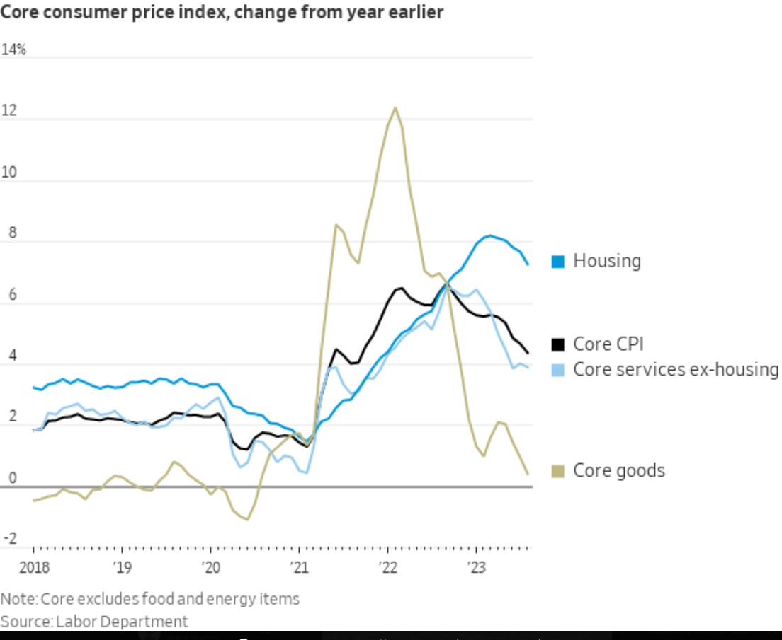
Deliberate Investing. Intentional Value.
hviaonline.com

Slide 4
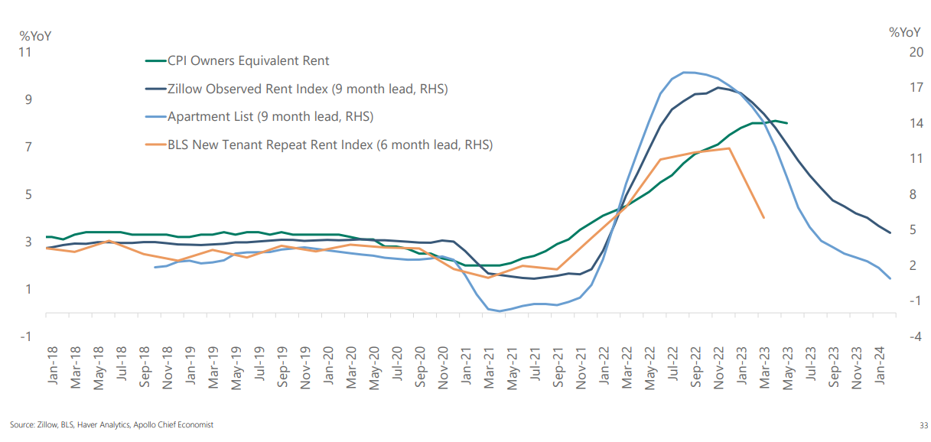
Deliberate Investing. Intentional Value.
Housing Inflation Coming Down
hviaonline.com

Slide 5
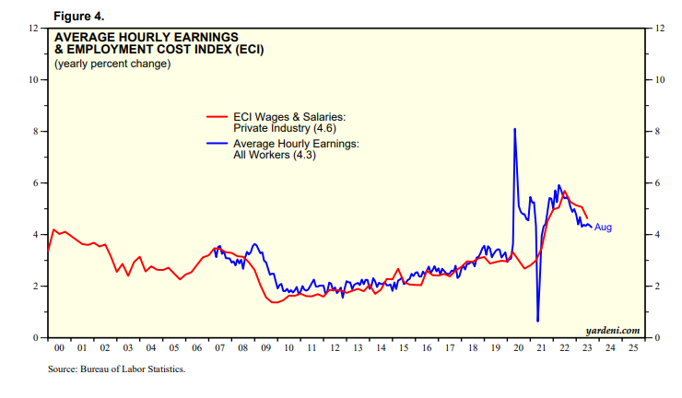
Deliberate Investing. Intentional Value.
hviaonline.com

Slide 6
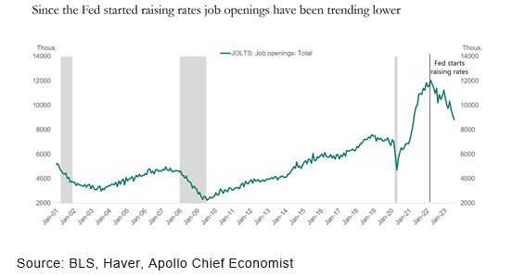
Deliberate Investing. Intentional Value.
hviaonline.com

Slide 7
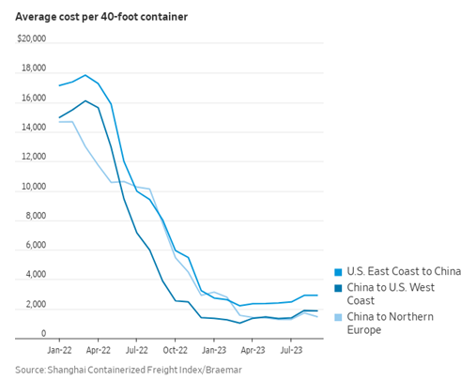
Deliberate Investing. Intentional Value.
hviaonline.com

Slide 8
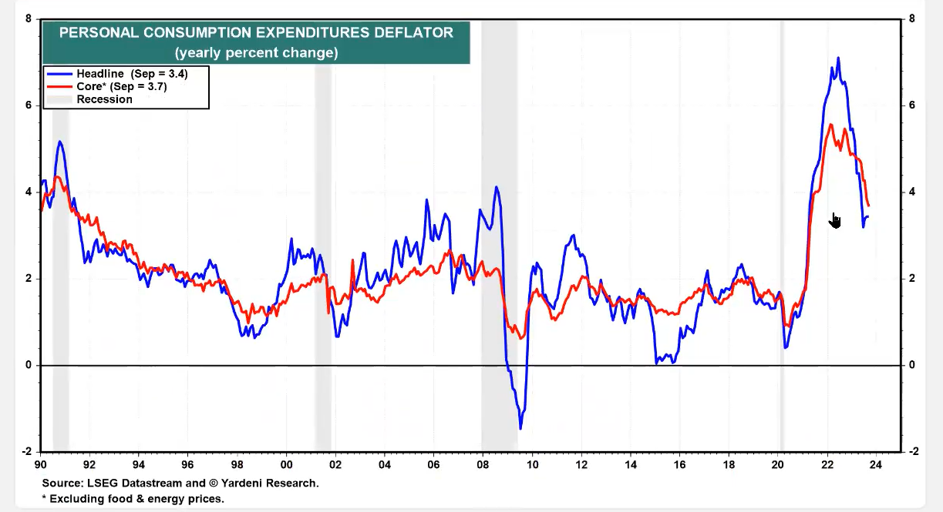
Deliberate Investing. Intentional Value.
hviaonline.com

Slide 9
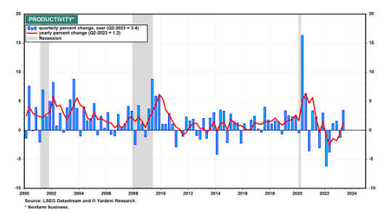
Deliberate Investing. Intentional Value.
hviaonline.com

Slide 10
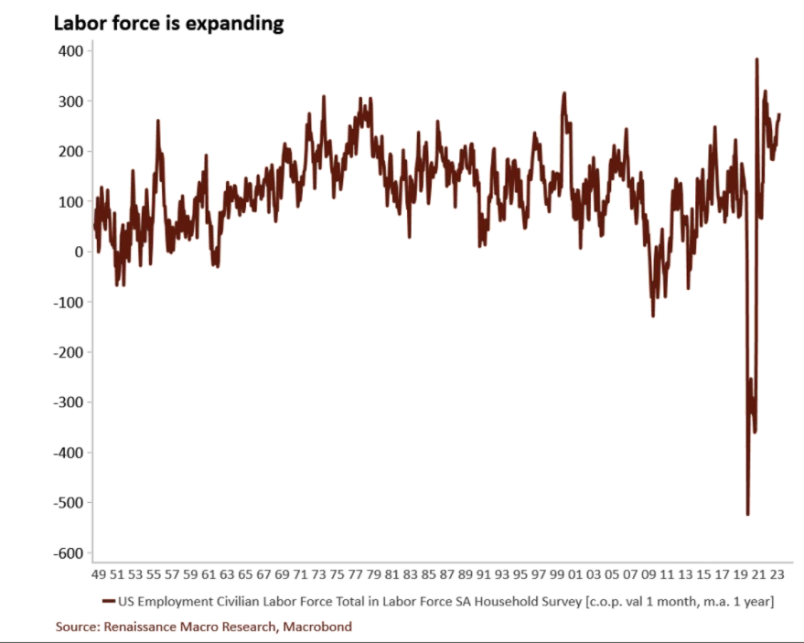
Deliberate Investing. Intentional Value.
hviaonline.com

Slide 11
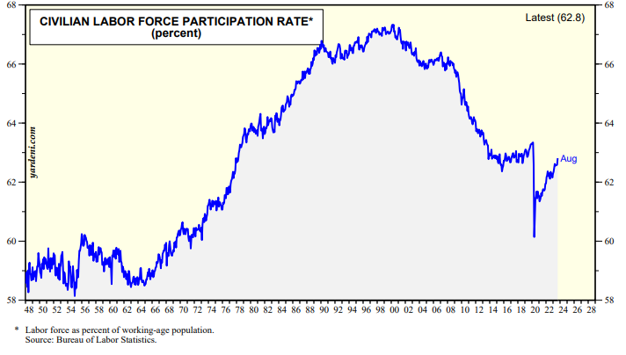
Deliberate Investing. Intentional Value.
hviaonline.com

Slide 12
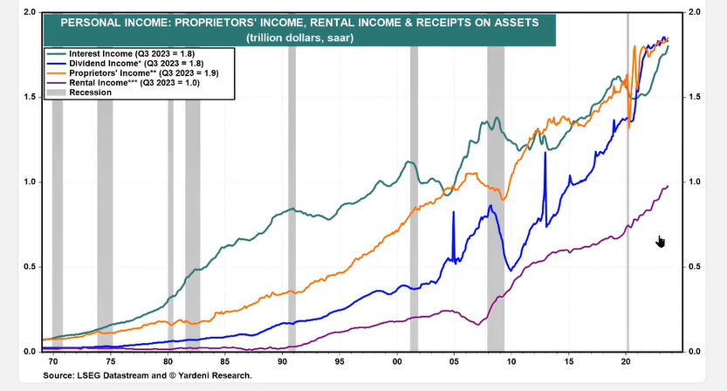
Deliberate Investing. Intentional Value.
hviaonline.com

Slide 13
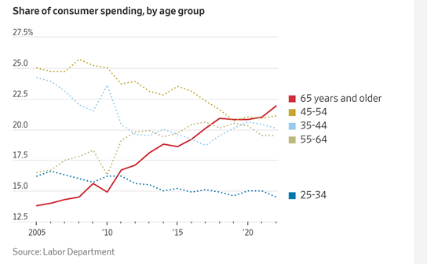
Deliberate Investing. Intentional Value.
hviaonline.com

Slide 14
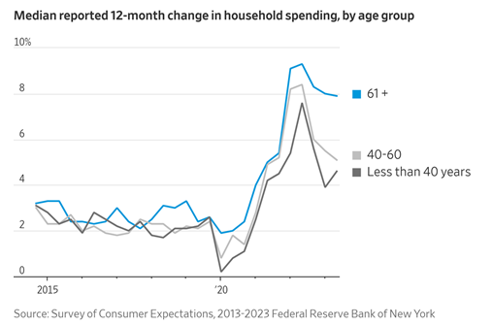
Deliberate Investing. Intentional Value.
hviaonline.com

Slide 15
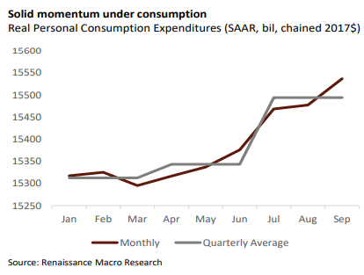
Deliberate Investing. Intentional Value.
hviaonline.com

Slide 16
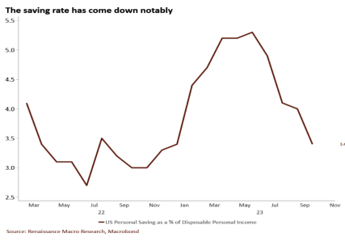
Deliberate Investing. Intentional Value.
hviaonline.com

Slide 17
Deliberate Investing. Intentional Value.
hviaonline.com

Slide 18
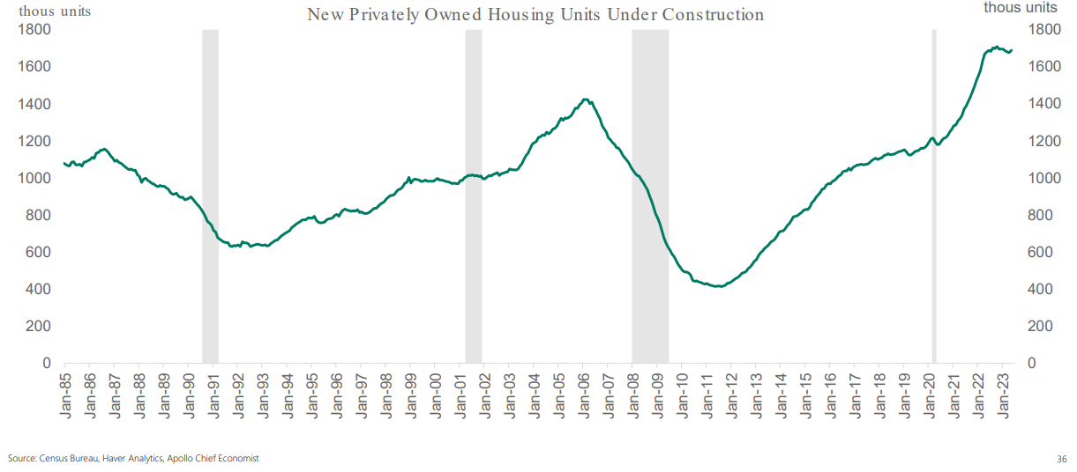
Deliberate Investing. Intentional Value.
hviaonline.com

Slide 19
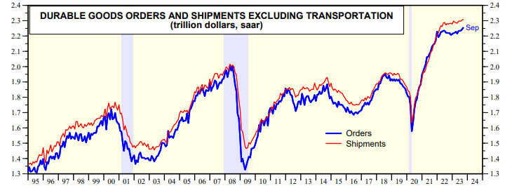
Deliberate Investing. Intentional Value.
Source: Yardeni Research
hviaonline.com

Slide 20
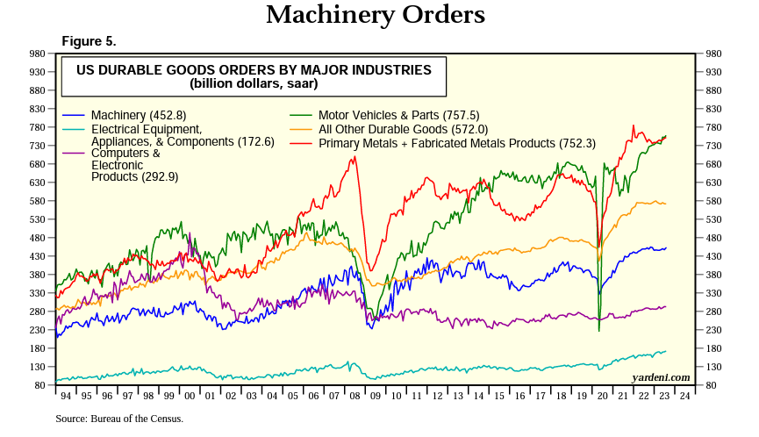
Deliberate Investing. Intentional Value.
Source: Yardeni Research
hviaonline.com

Slide 21
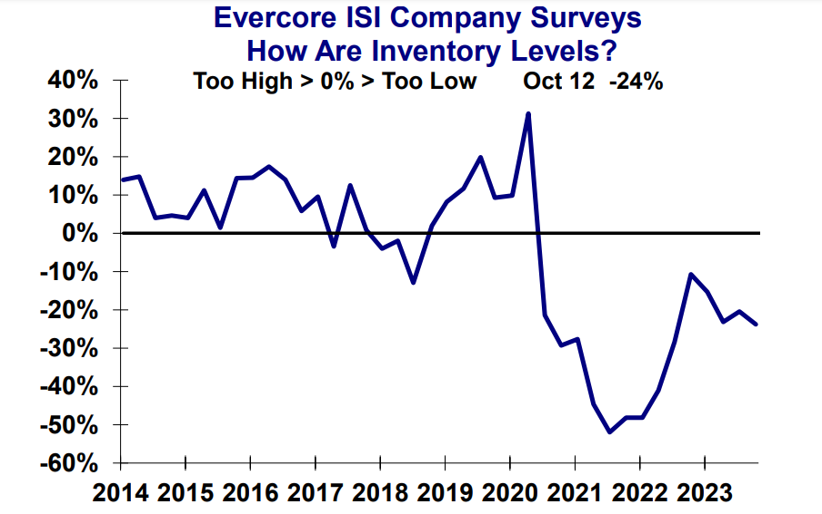
Deliberate Investing. Intentional Value.
Source: ISI Research
hviaonline.com

Slide 22
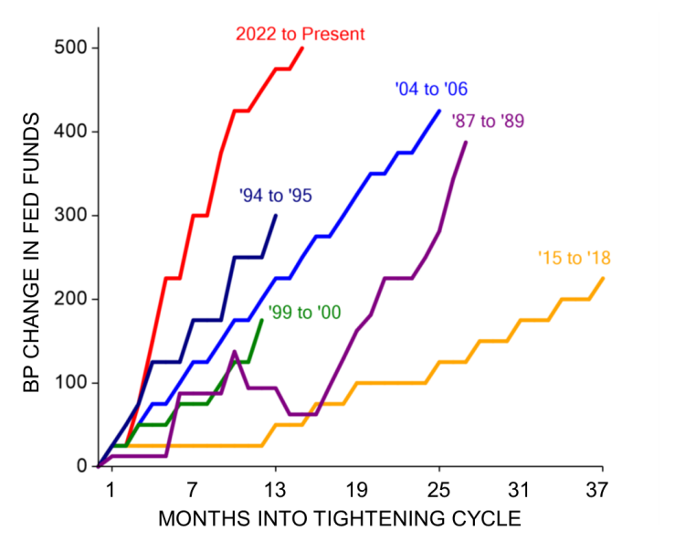
Deliberate Investing. Intentional Value.
Fastest pace of rate increases in 35 years
Source: ISI Research
hviaonline.com

Slide 23
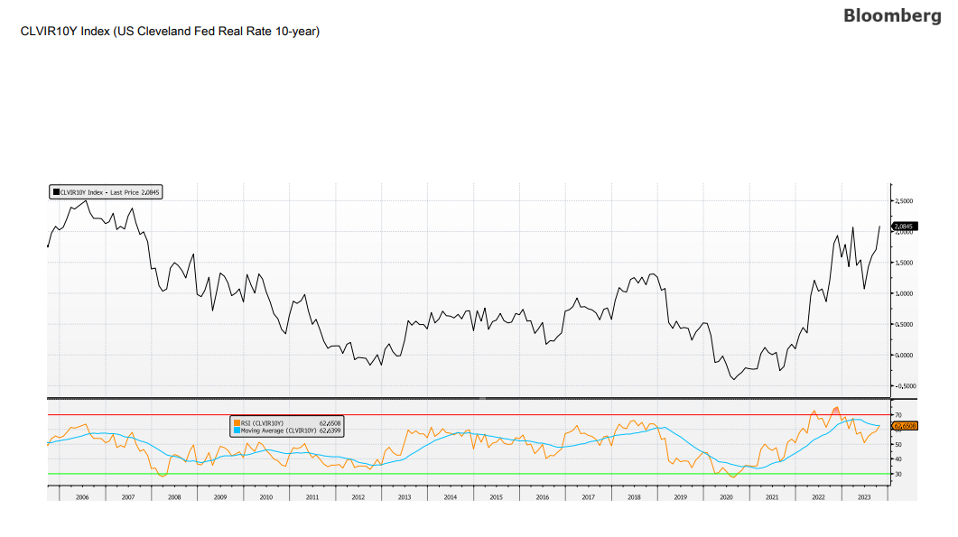
Deliberate Investing. Intentional Value.
hviaonline.com

Slide 24
Deliberate Investing. Intentional Value.
Source: RenMac
hviaonline.com

Slide 25
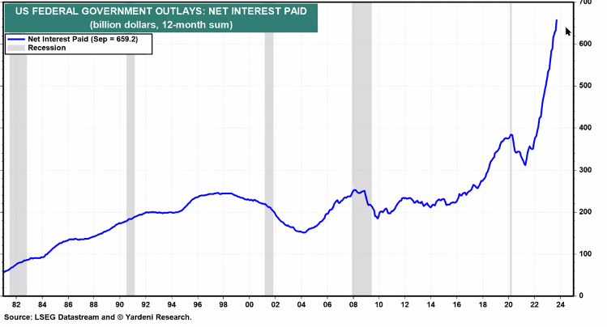
Deliberate Investing. Intentional Value.
Historical Markets
hviaonline.com

Slide 26
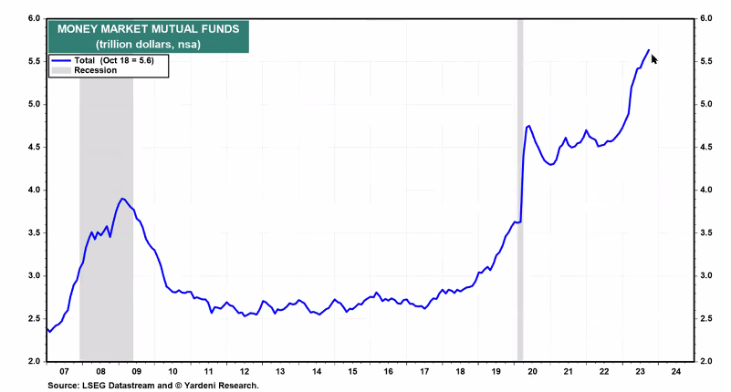
Deliberate Investing. Intentional Value.
Historical Markets
hviaonline.com

Slide 27
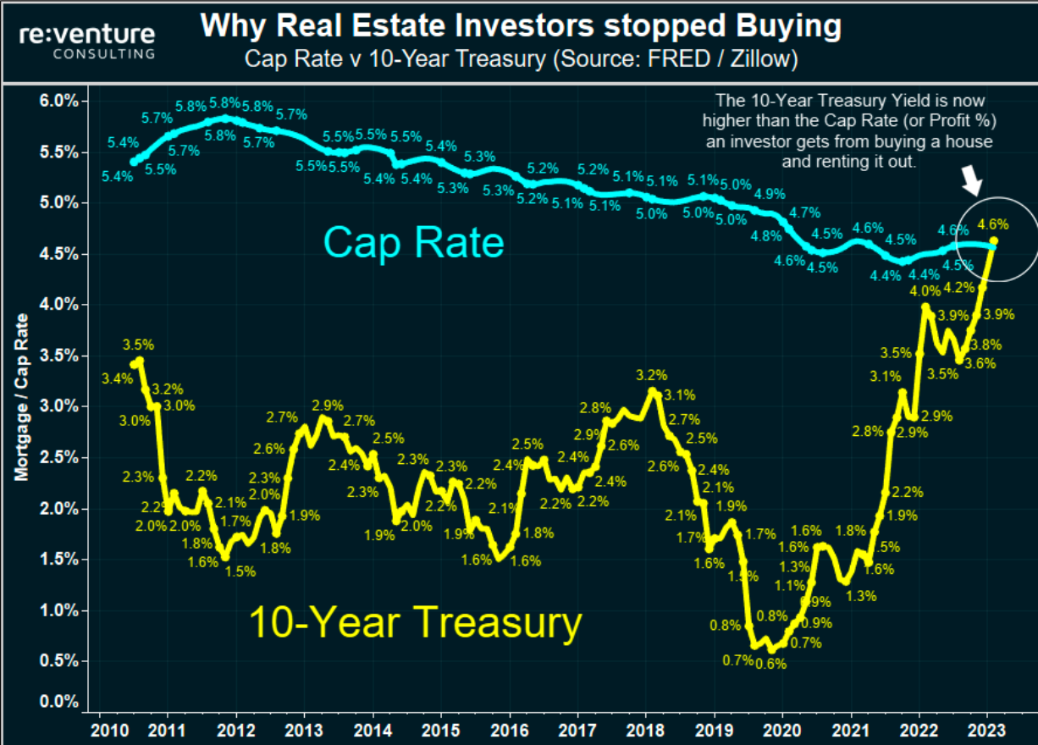
Deliberate Investing. Intentional Value.
Source: Fred/Zillow
hviaonline.com

Slide 28
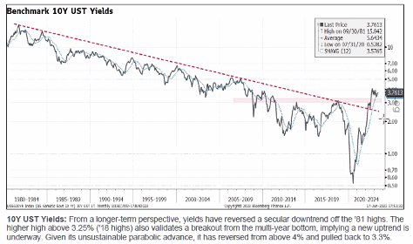
Deliberate Investing. Intentional Value.
Change in longer term interest rates/cycles are long
Source: Piper Jaffary
hviaonline.com

Slide 29
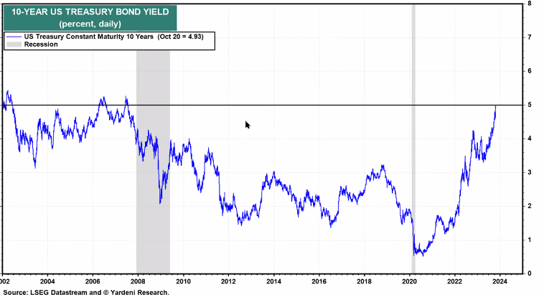
Deliberate Investing. Intentional Value.
Historical Markets
hviaonline.com

Slide 30
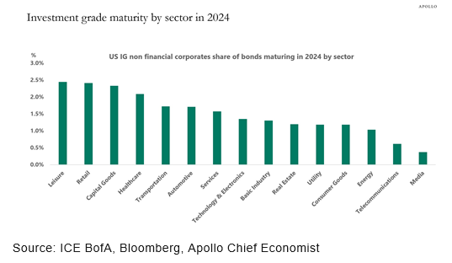
Deliberate Investing. Intentional Value.
hviaonline.com

Slide 31
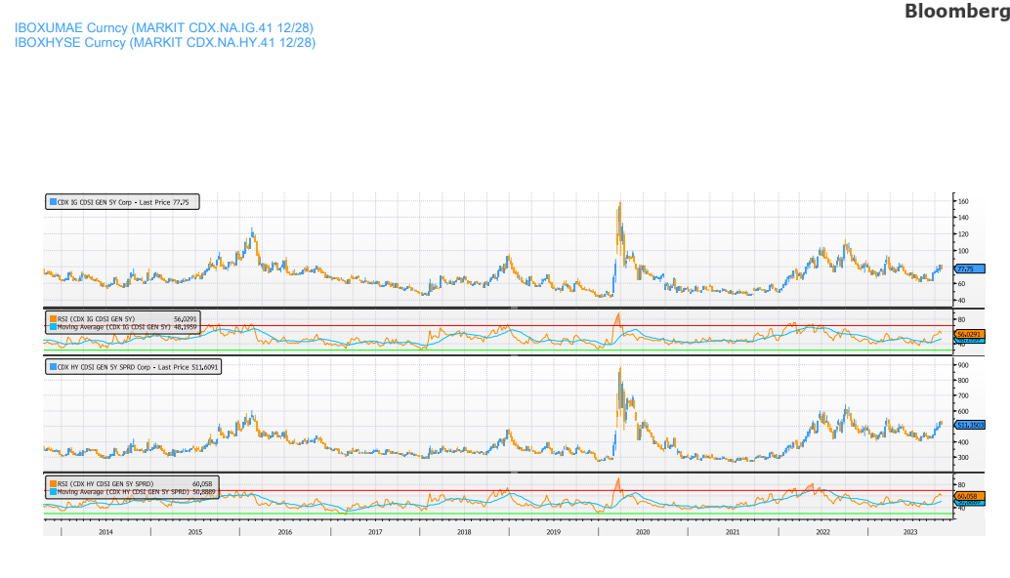
Deliberate Investing. Intentional Value.
Source: Bloomberg
hviaonline.com

Slide 32
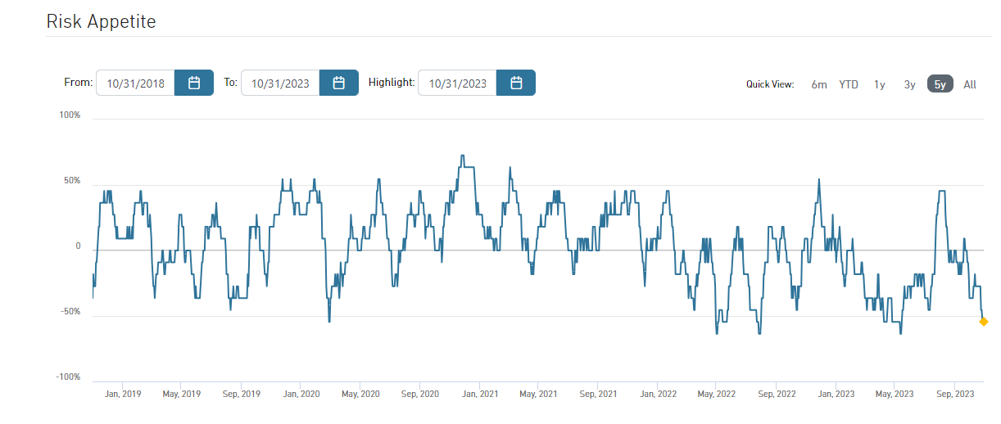
Deliberate Investing. Intentional Value.
Source: State Street
hviaonline.com

Slide 33
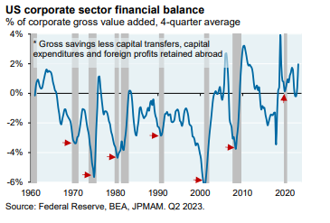
Deliberate Investing. Intentional Value.
hviaonline.com

Slide 34
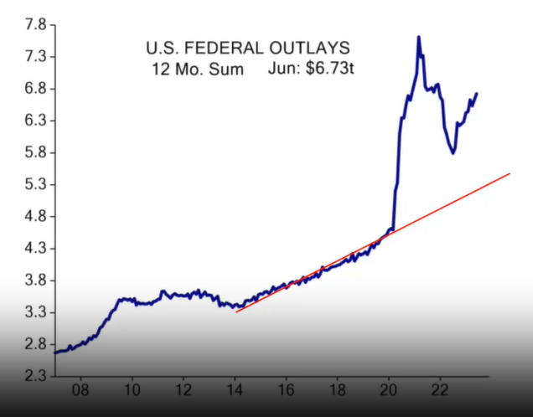
Deliberate Investing. Intentional Value.
Stimulative Impact of Government Spending
Source: ISI
hviaonline.com

Slide 35
Deliberate Investing. Intentional Value.
hviaonline.com

Slide 36
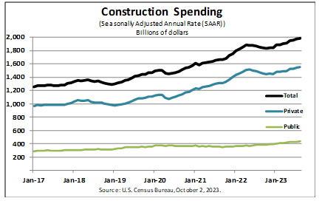
Deliberate Investing. Intentional Value.
hviaonline.com

Slide 37
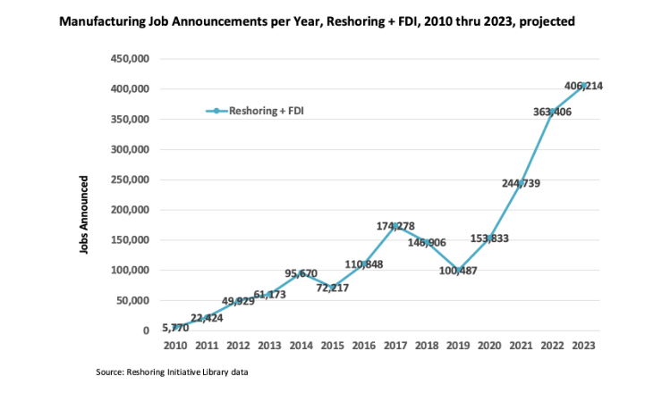
Deliberate Investing. Intentional Value.
hviaonline.com

Slide 38
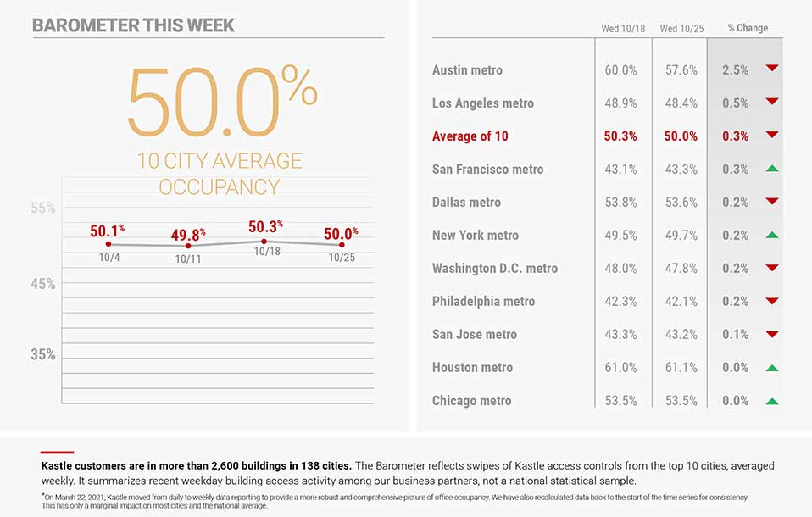
Deliberate Investing. Intentional Value.
Return to the Office is Expected to Show Improvement
Source: Kastle Systems
hviaonline.com

Slide 39
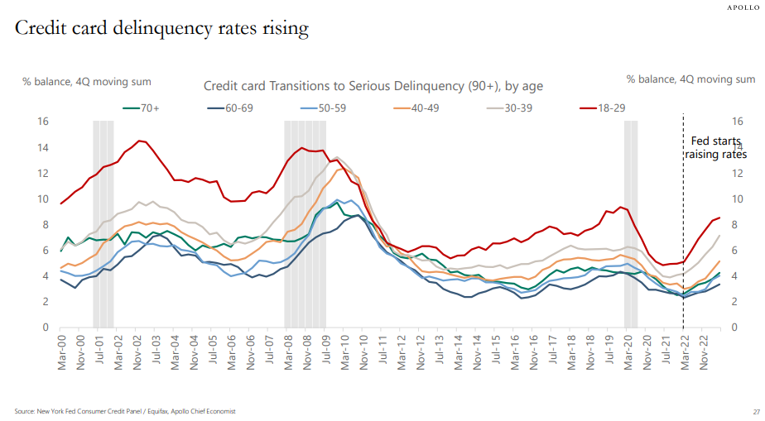
Deliberate Investing. Intentional Value.
hviaonline.com

Slide 40
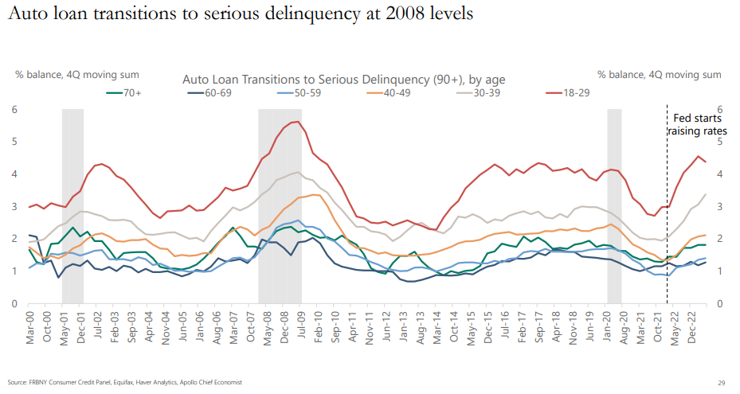
Deliberate Investing. Intentional Value.
hviaonline.com

Slide 41
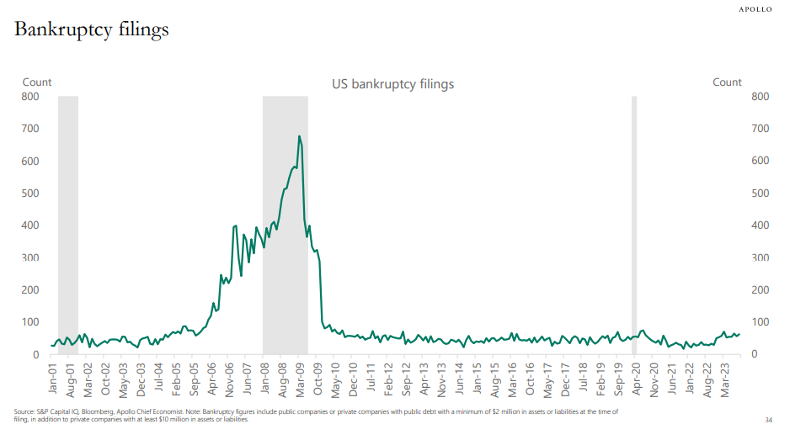
Deliberate Investing. Intentional Value.
hviaonline.com

Slide 42
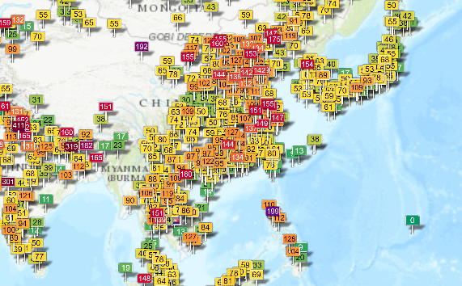
Deliberate Investing. Intentional Value.
China Pollution Levels to Gage Economic Activity- 92423
Source: ACICN.ORG
hviaonline.com

Slide 43
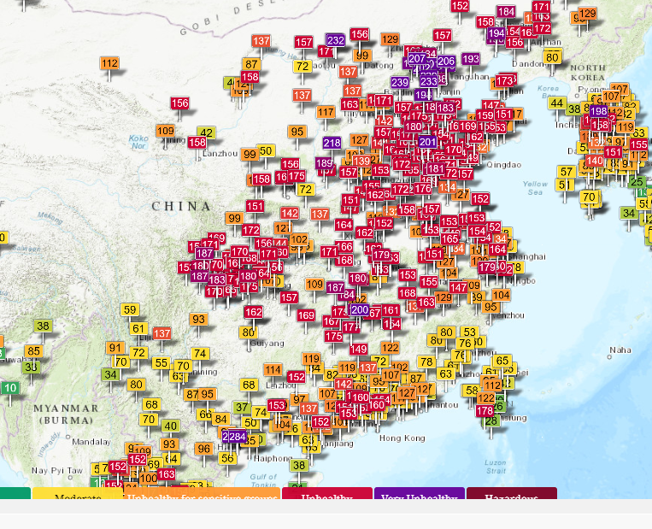
Deliberate Investing. Intentional Value.
China Pollution Levels to Gage Economic Activity- 110223
Source: ACICN.ORG
hviaonline.com

Slide 44
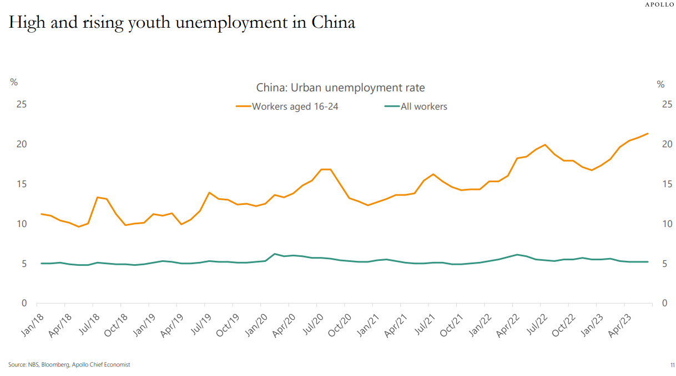
Deliberate Investing. Intentional Value.
hviaonline.com

Slide 45
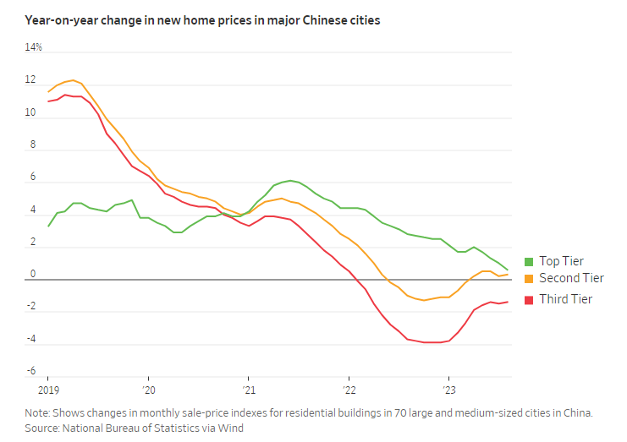
Deliberate Investing. Intentional Value.
hviaonline.com

Slide 46
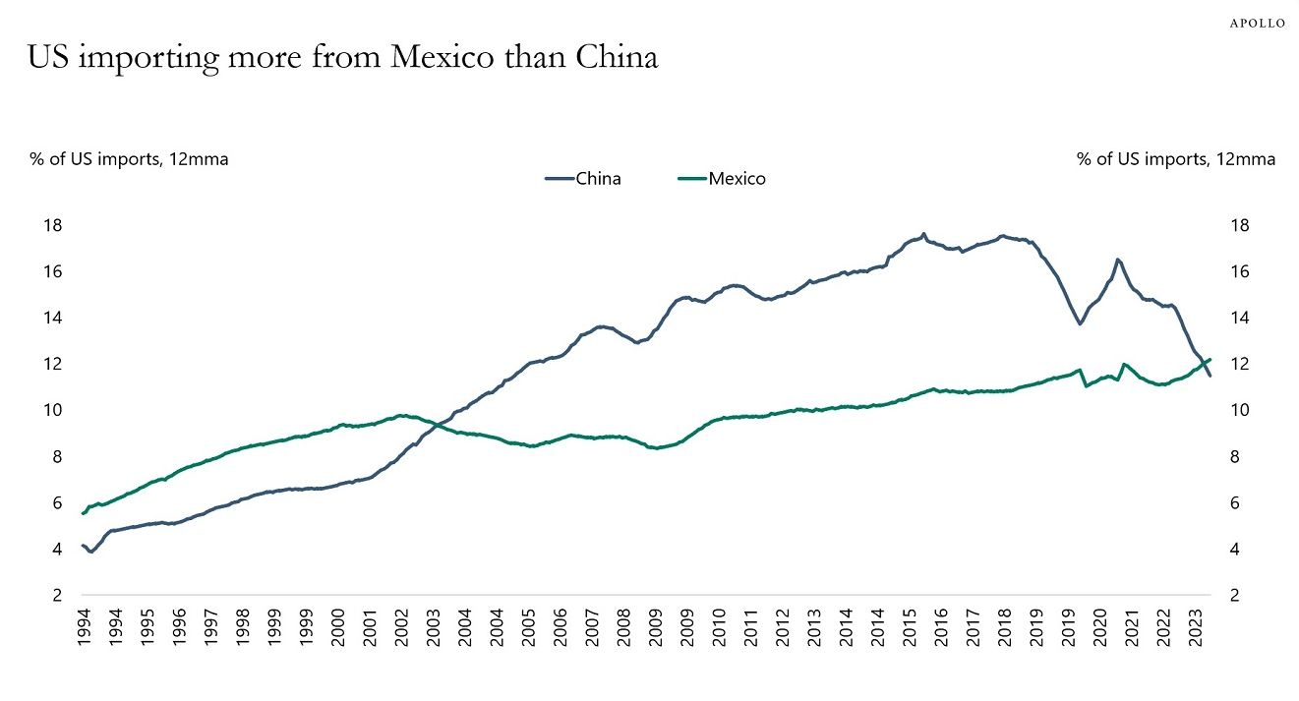
Deliberate Investing. Intentional Value.
Source: Apollo
hviaonline.com

Slide 47
Deliberate Investing. Intentional Value.
Source: Datatrek Research
hviaonline.com

Slide 48
Deliberate Investing. Intentional Value.
Source: Datatrek Research
hviaonline.com

Slide 49
Deliberate Investing. Intentional Value.
Source: Bianco Research
hviaonline.com

Slide 50
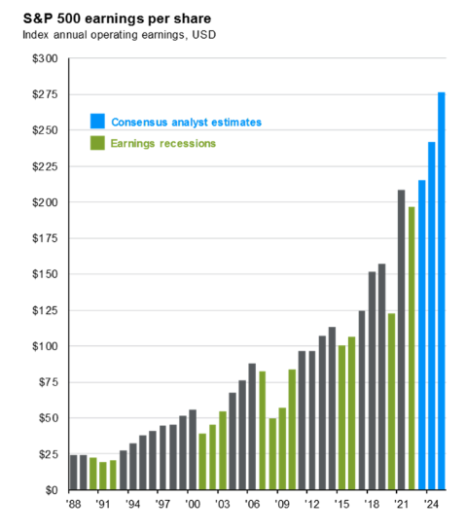
Deliberate Investing. Intentional Value.
Source: Standard & Poor’s
hviaonline.com

Slide 51
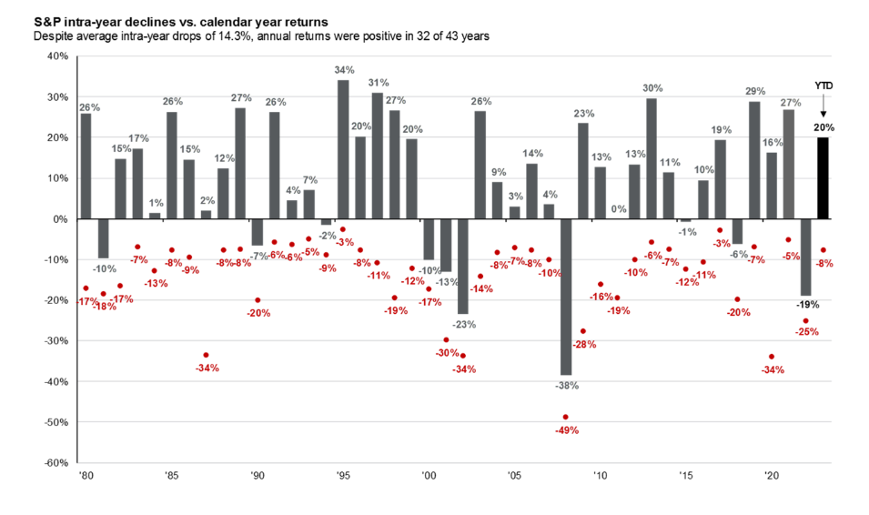
Deliberate Investing. Intentional Value.
Historical Markets
Source: S&P 500, JP Morgan
hviaonline.com

Slide 52
Deliberate Investing. Intentional Value.
KEY TAKEAWAYS
Moving toward a pre-great financial crisis economy
The consumer is the key to the current economy
Inflation is moving lower but may now be showing fits and starts due to energy and other commodities
No recession – HVIA’s position for the past year +
Moving forward higher for longer interest rate environment
Moving to a broader market improvement away from a handful of names
Earnings have bottomed and we are moving higher through the remainder of ‘23 and into ’24
Bonds are most likely to see a reversion to the 3 ½ to 5% percent range moving forward
=============================================================
Maintain equity exposure
Corporate Bonds provide solid returns // Barbell 2 year – 8 to 10 year exposures
Moving to a pre 2008 environment for markets
Rest of world is slowing (China/Germany)
Active, deliberate investment management is working
hviaonline.com

Slide 53
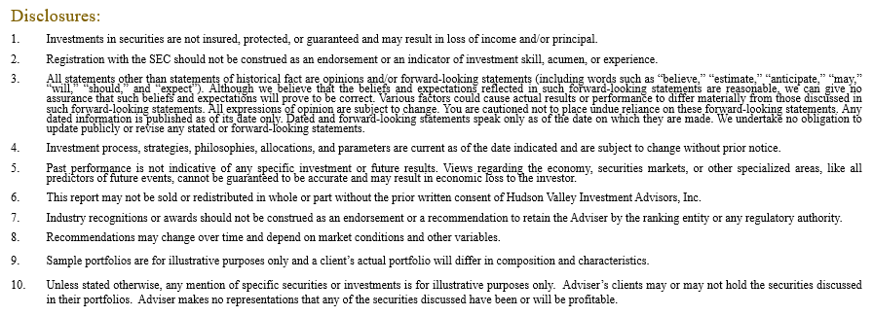
Tel: 845-294-6127 | Fax: 845-294-1438 | hviaonline.com

